Slide 1
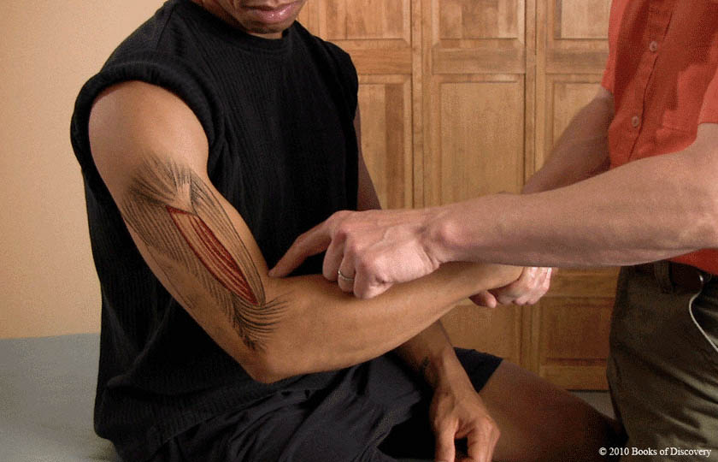
Brachialis

Slide 2
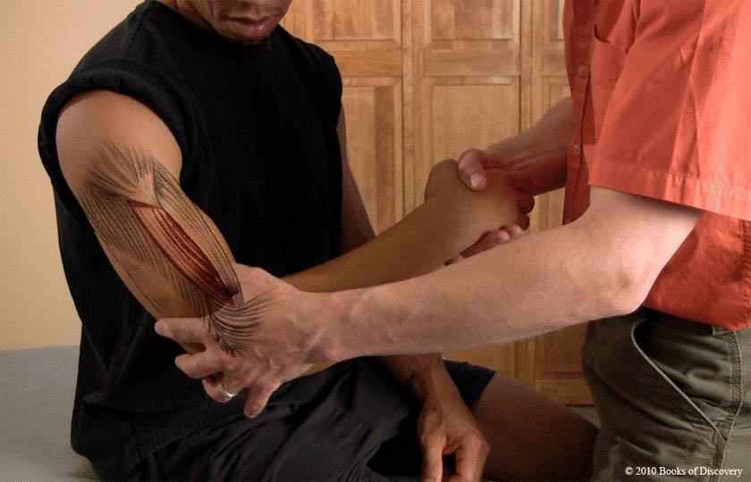
Brachialis – palpate

Slide 3
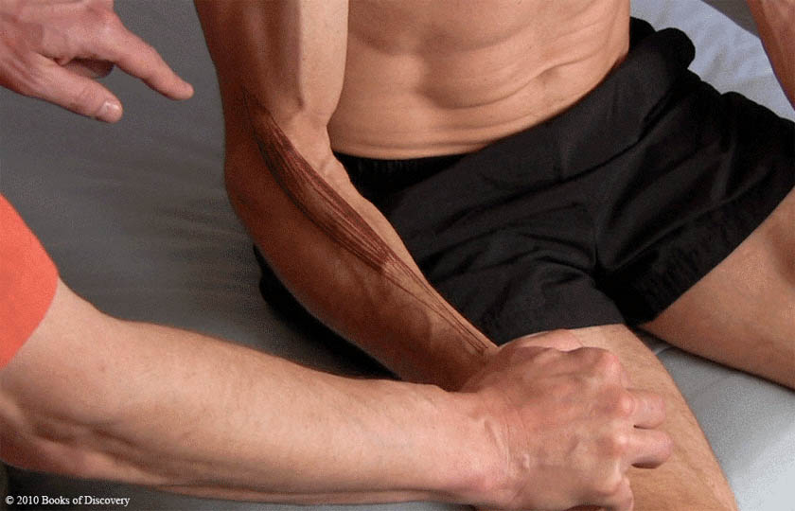
Brachioradialis

Slide 4
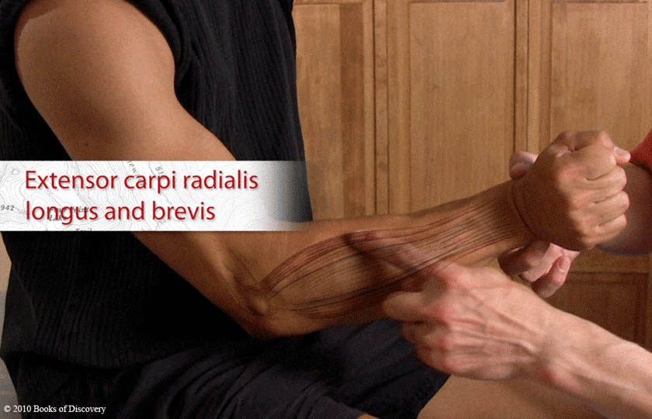
Extensor carpi radialis longus and brevis

Slide 5
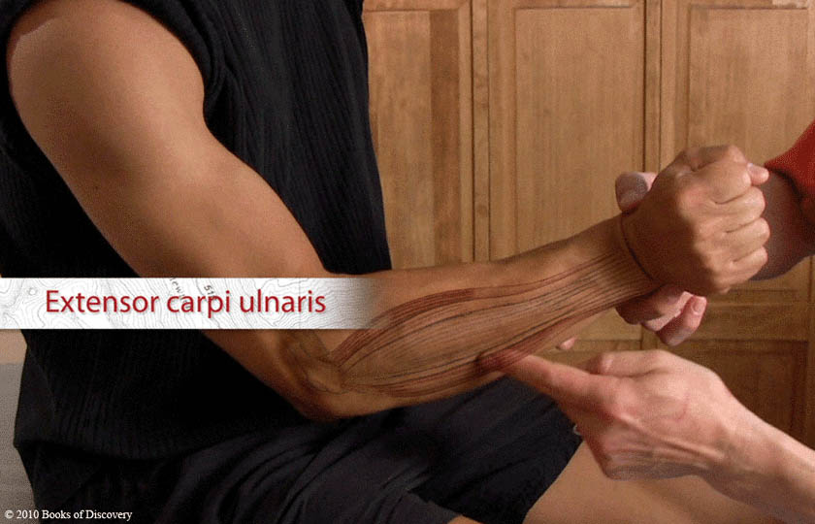
Extensor carpi ulnaris

Slide 6
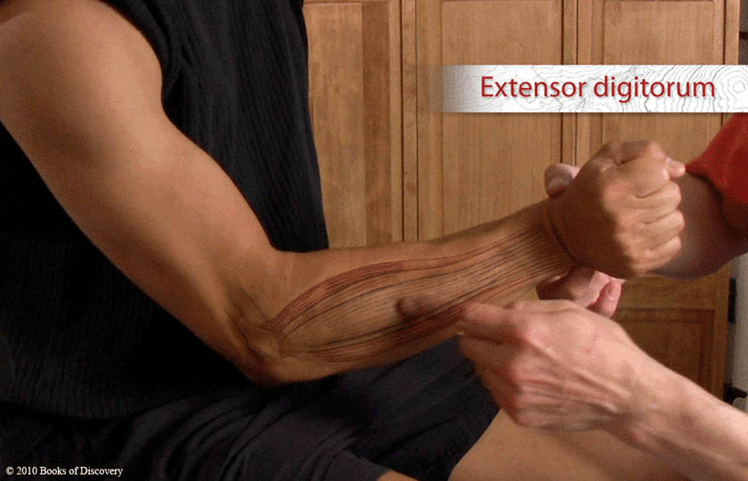
Extensor digitorum

Slide 7
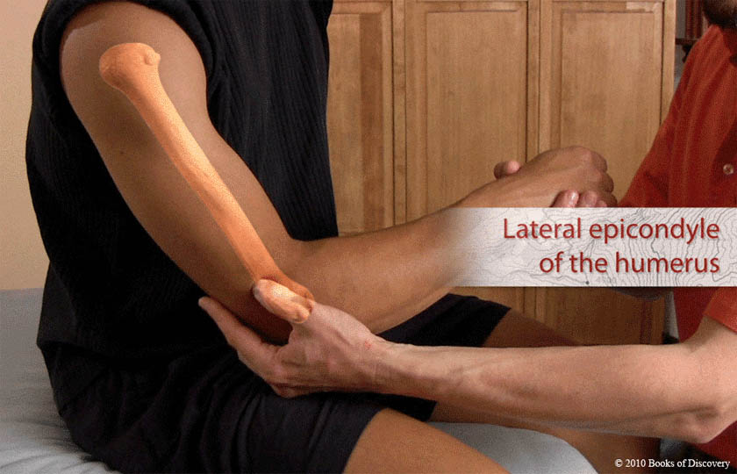
Lateral epicondyle of the humerus

Slide 8
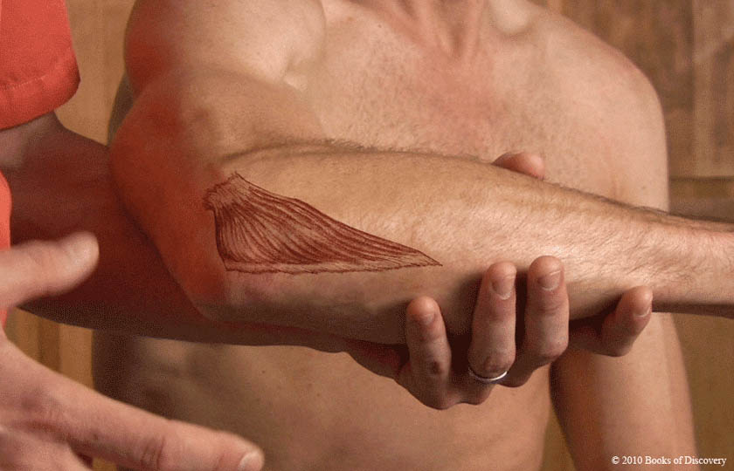
Anconeus

Slide 9
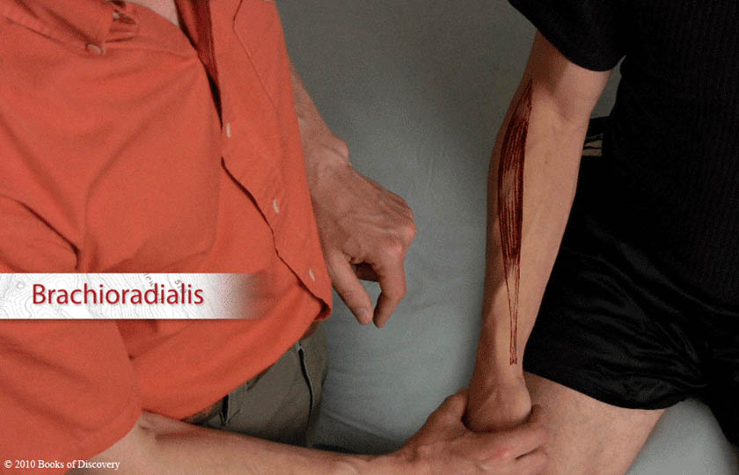
Brachioradialis

Slide 10
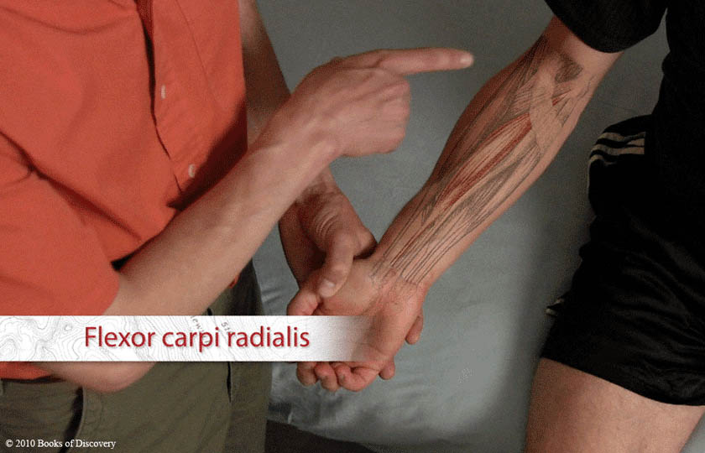
Flexor carpi radialis

Slide 11
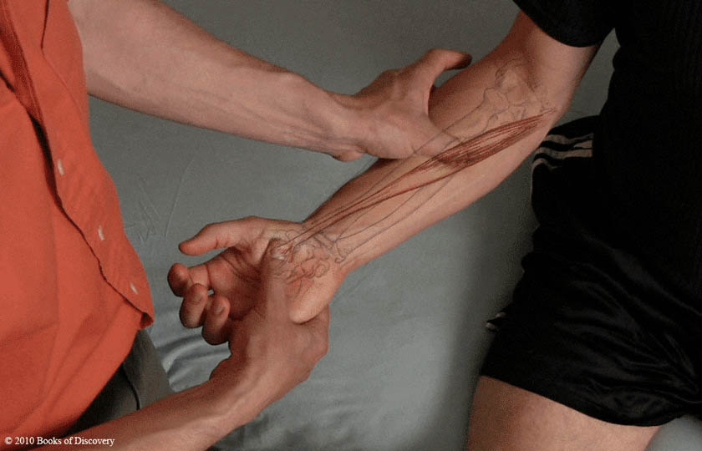
Flexor carpi radialis – palpate

Slide 12
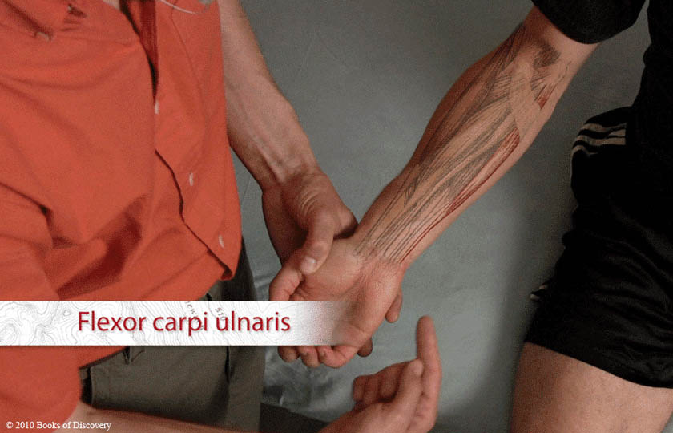
Flexor carpi ulnaris

Slide 13
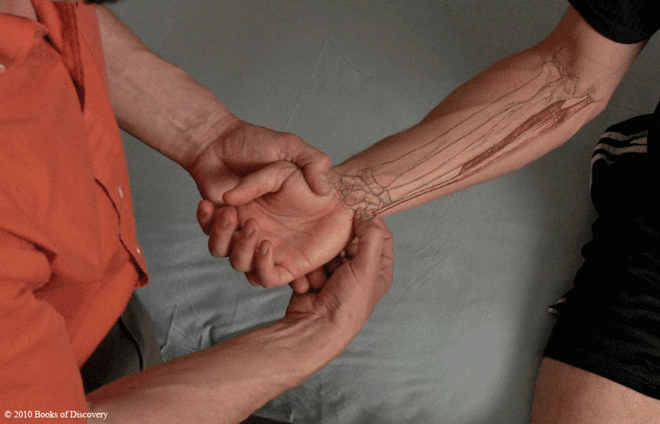
Flexor carpi ulnaris – palpate

Slide 14
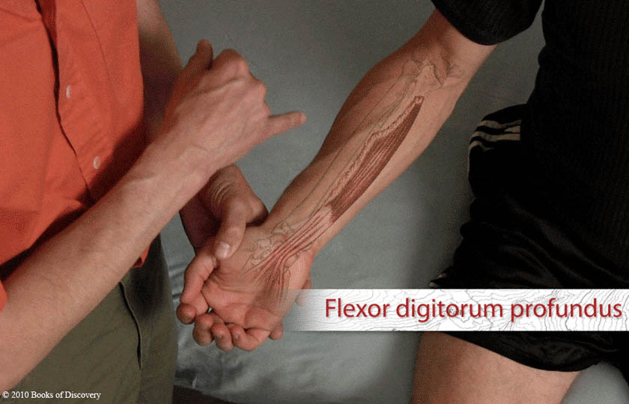
Flexor digitorum profundus

Slide 15
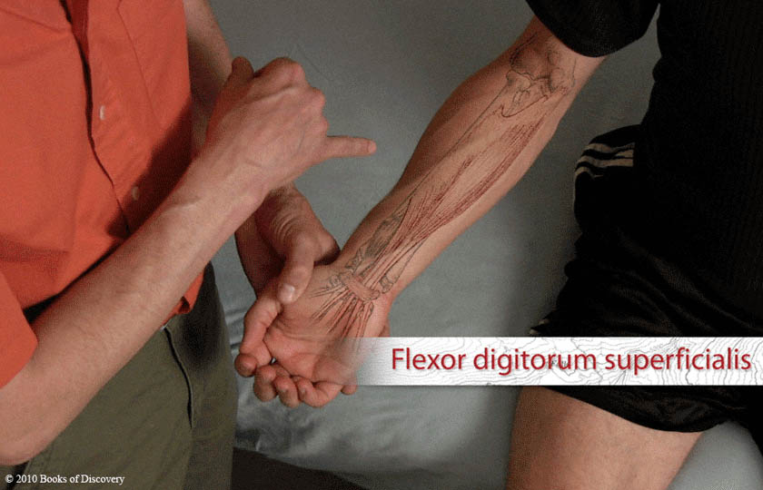
Flexor digitorum superficialis

Slide 16
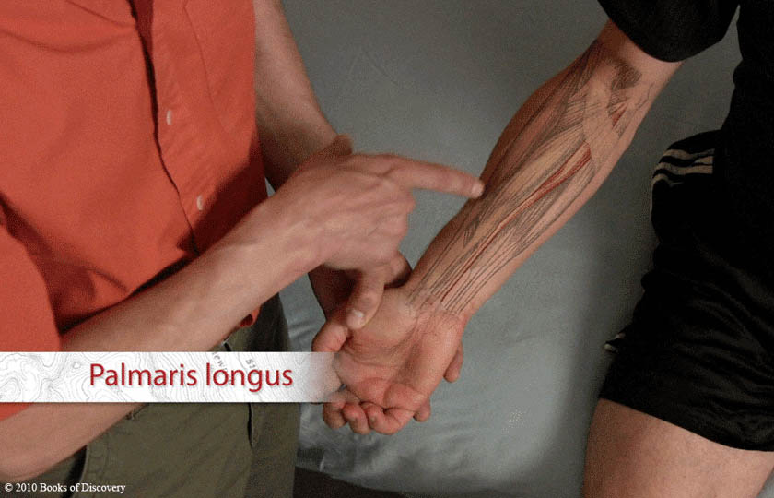
Palmaris longus

Slide 17
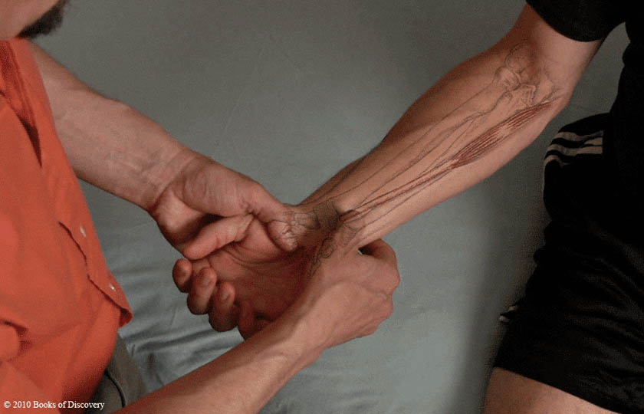
Palmaris longus – palpate

Slide 18
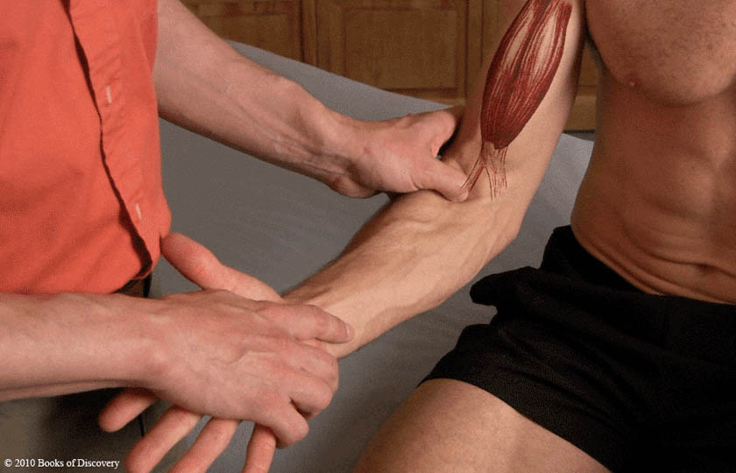
Biceps tendon

Slide 19
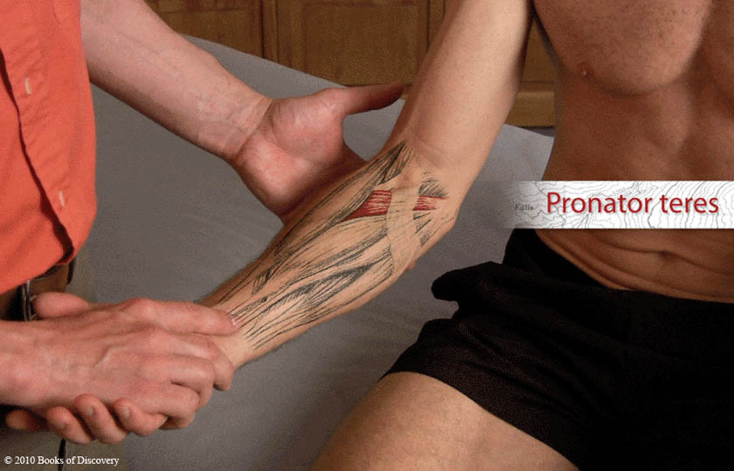
Pronator teres

Slide 20
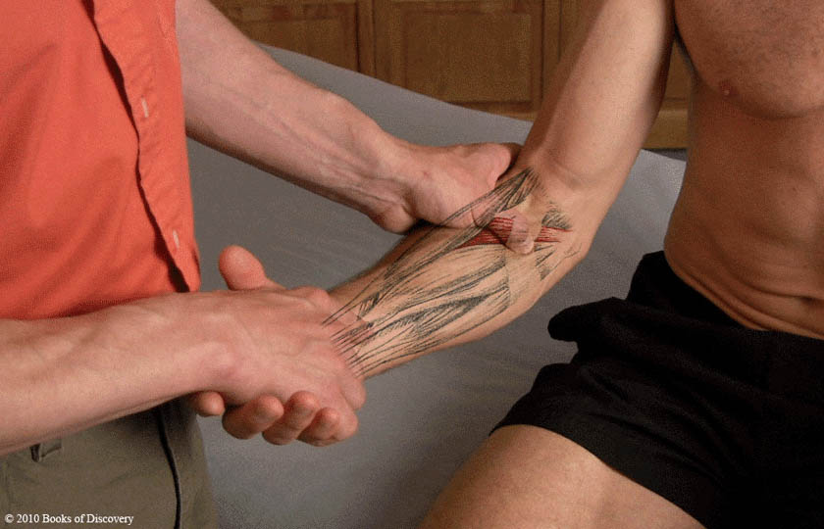
Pronator teres – palpate

Slide 21
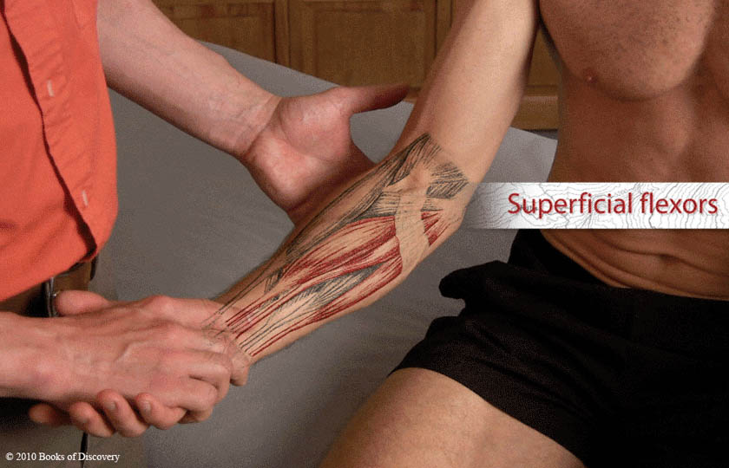
Superficial flexors

Slide 22
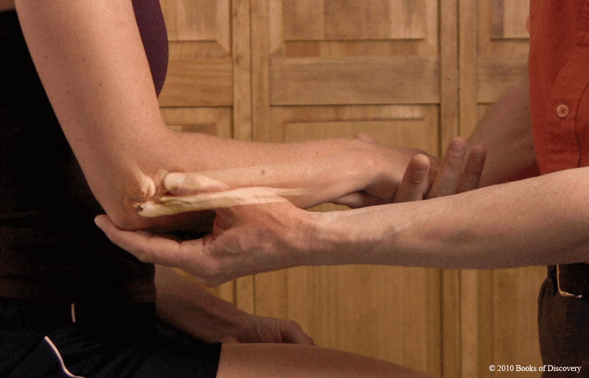
Head of radius

Slide 23
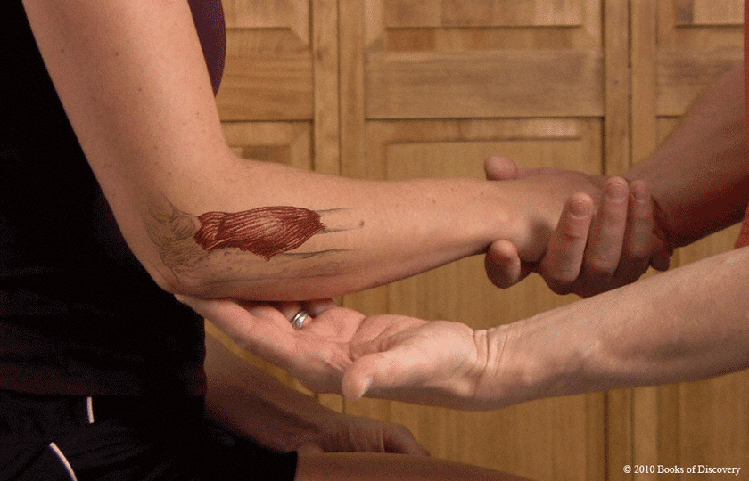
Supinator

Slide 24
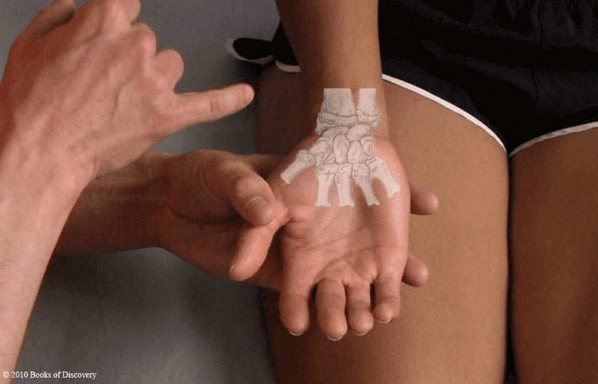
Carpals

Slide 25
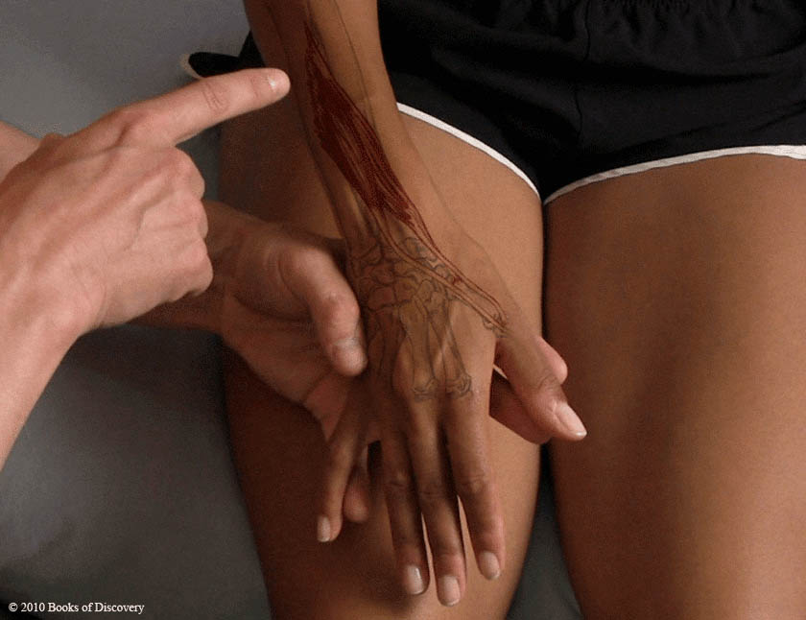
Long thumb muscles

Slide 26
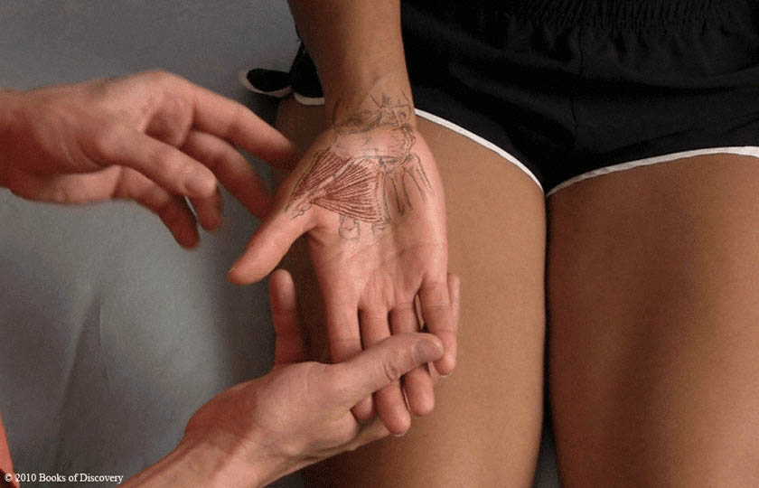
Short thumb muscles

